Slide 1
03 | Simple scripts and functions
Jeffrey Snover | Distinguished Engineer & Lead Architect
Jason Helmick | Senior Technologist, Concentrated Technology

Slide 2
Module Overview
Turning command into scripts for automation
Choosing your variables to parameterize
Adding parameters to your script
Functions
Running your scripts/functions

Slide 3
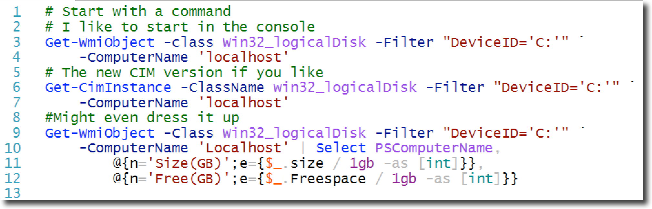
Turning commands into scripts

Slide 4
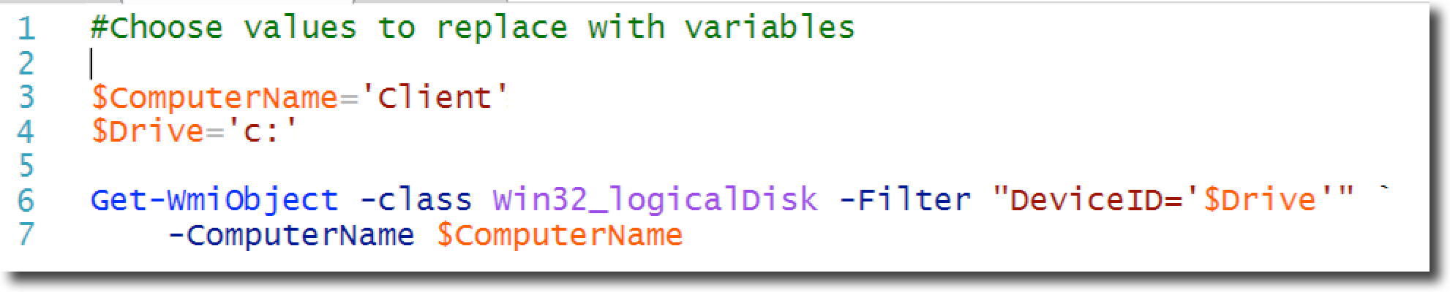
Choose your variables to parameterize

Slide 5
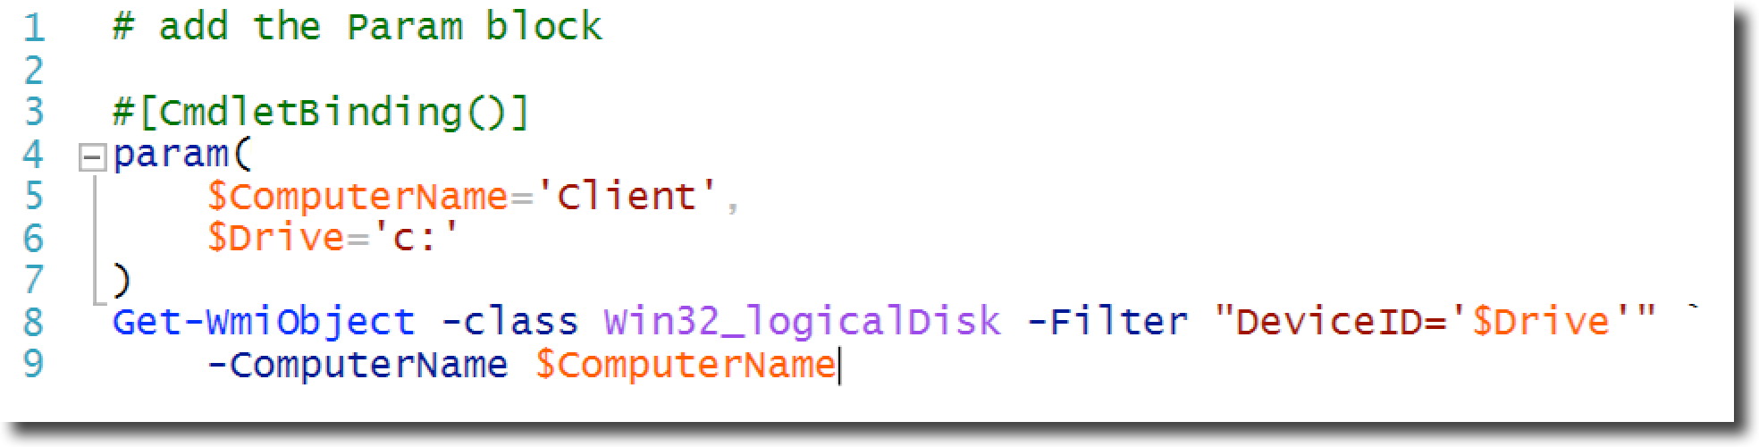
Parameterizing your Script

Slide 6
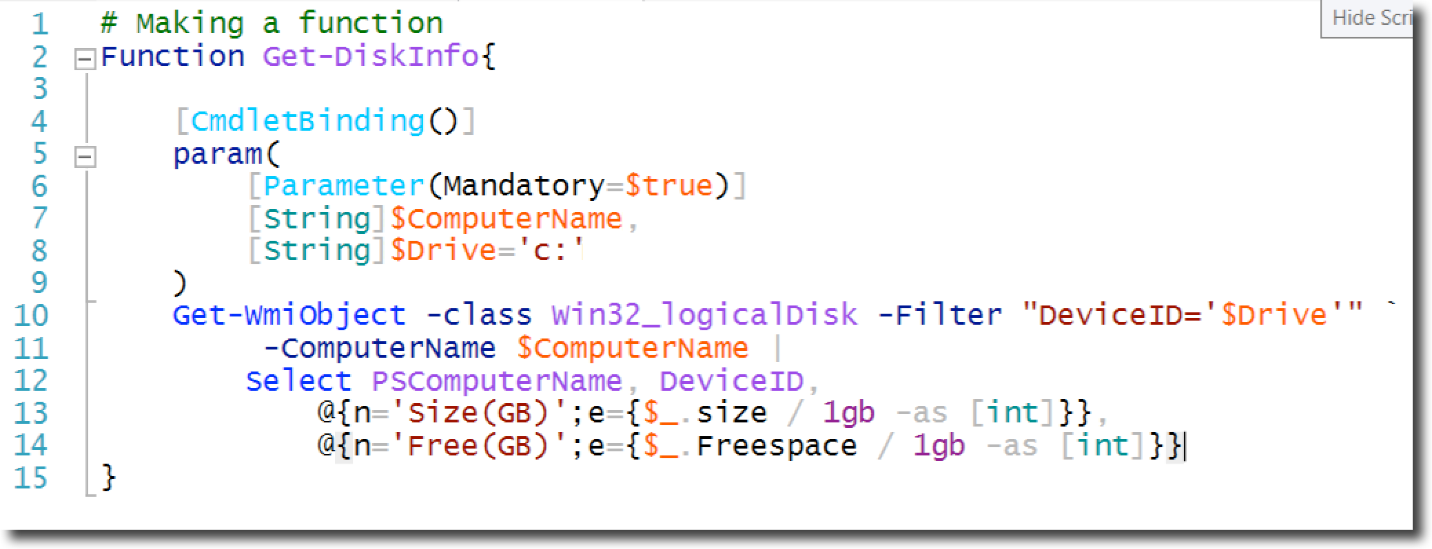
Functions

Slide 7
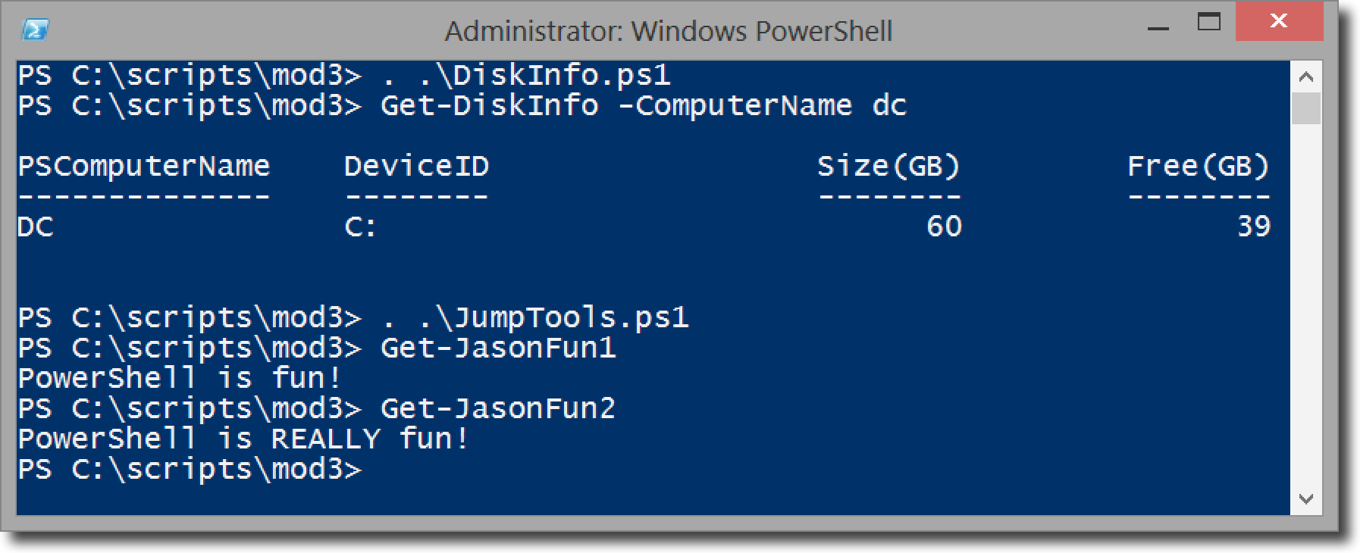
Running your scripts/functions

Slide 8
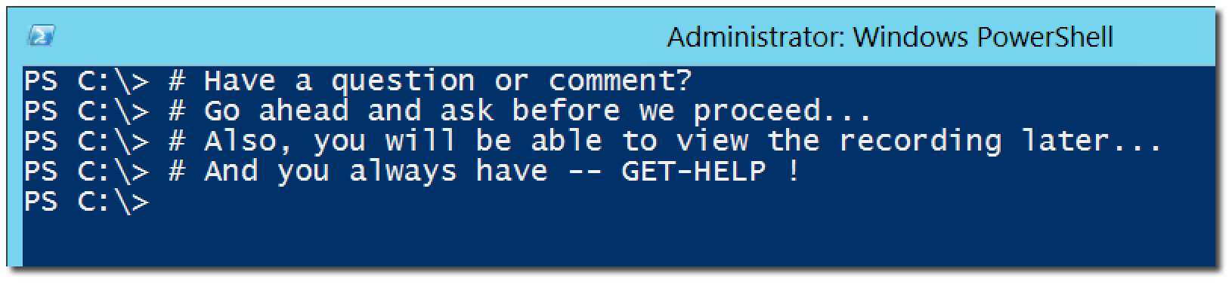
Questions or comments?

